Slide 1
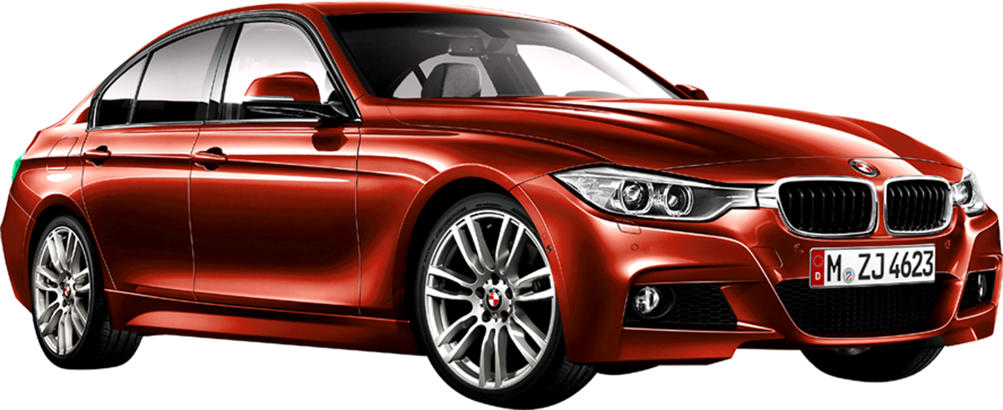
Used Cars Analysis
Runlin Chen - Thomas Algenio - Jean Pino - Ethan Weiss
Professor Mamonov
INFO 368

Slide 2
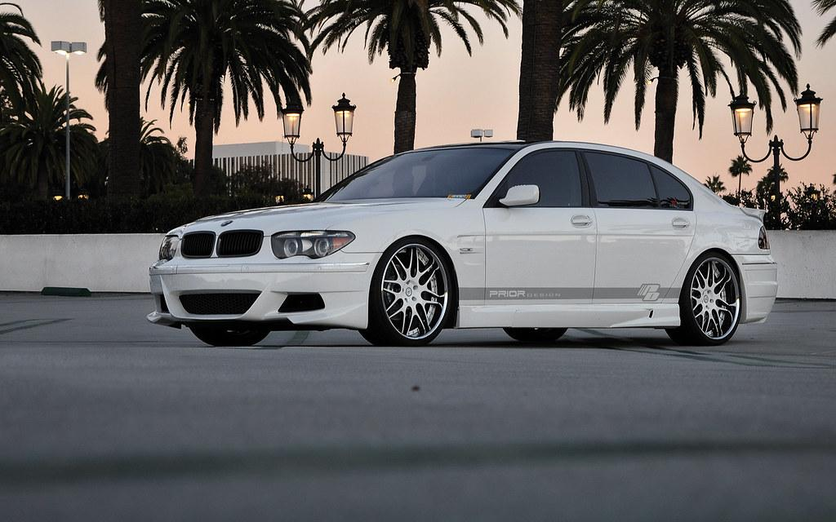
Introduction

Slide 3
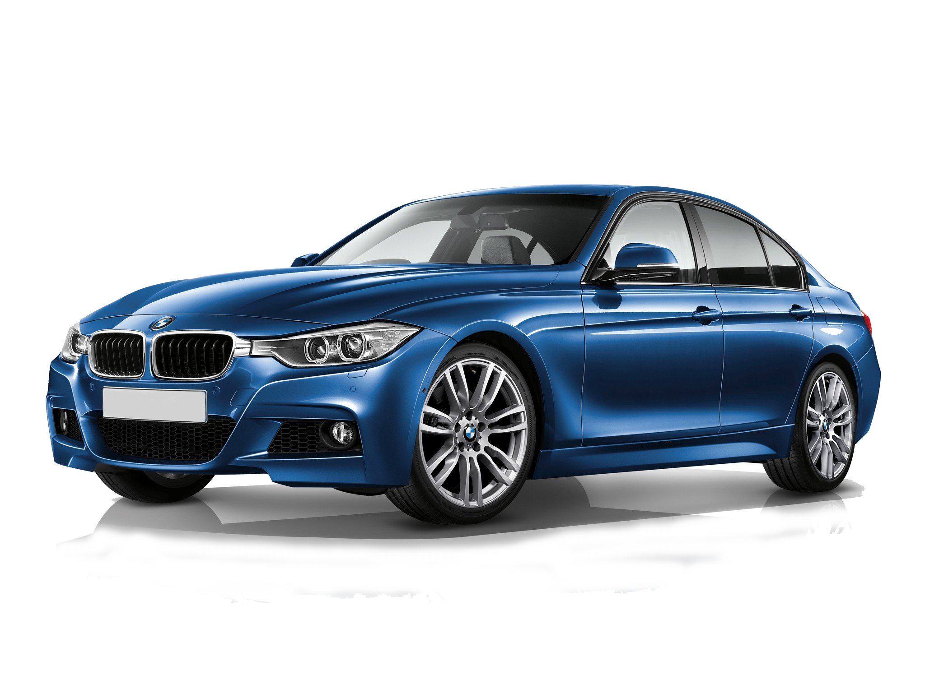
Business Case
How much do optional features affect the value of a used vehicle?
Notes:
According to various online reports, a vehicle decreases in value as much as 20% in the first 12 months
So with our research we aim to determine:
Common Factors (Condition, Year, Mileage, etc)
Optional features/packages
Bluetooth
Navigation
Sunroof
Predictive Model to evaluate overall features that affect value the most

Slide 4
Business Case (Cont.)
Customers
Overpaying (Priced Above Market Value)
Potential Savings
Used vs New
Better Offer
Trade-In Value
Dealers
Competition & Online Pricing
Potential Profits
Market Value
Notes:
The impact of our study in perspective of the customer and the dealer.
Customers: With the results, car buyers will be able to see if they are overpaying for a used vehicle & if they are paying above market value
Which leads to the potential savings from buying smart and finding the best value for a used vehicle. With the knowledge of a vehicle’s worth, buyers will also be able to negotiate a better offer.
And if a buyer wants to trade their vehicle in, they will be able to do it confidently with knowledge of their car’s value.
Dealers: If they are overpricing the vehicle, they potentially risk losing customers to other dealers as inventory is displayed online for everyone to see. Dealers can also determine the cost of vehicles based on its true value in order to make a profit.

Slide 5

Used Car Market
Secondary Market Data
Used Vs New
BMW 3 Series
Features By Trim
As Optional Packages
Notes:
For our research, We used data from secondary market as an example as it would be more accurate when researching the depreciation of a vehicle. The data for used vehicles were collected from sites like edmunds.com, autotrader, and KellyBlueBook
Trims is the standard set of features already in the vehicles , Higher Trims =More or Better Features, Higher Trims = Higher Prices
As Optional Packages---Standard ($300) to Premium ($3100)
Light
Cold Weather
Driver Assistance
Technology
Sport
Premium

Slide 6
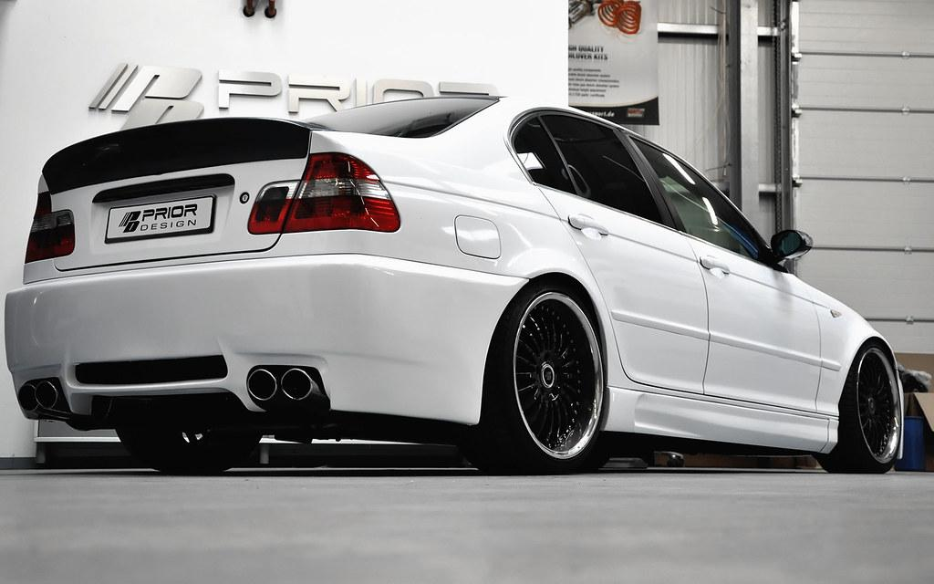
Background Information

Slide 7
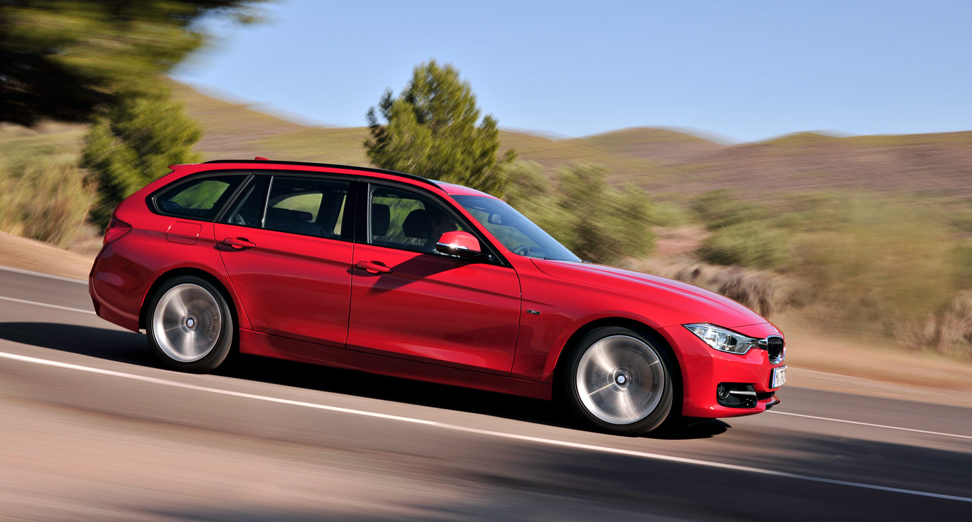
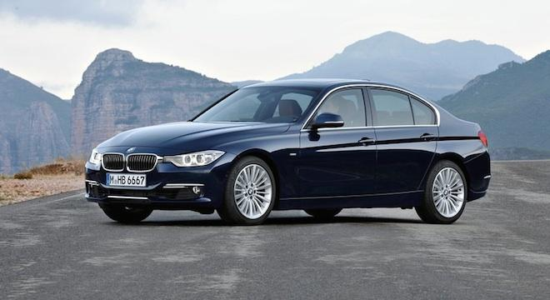
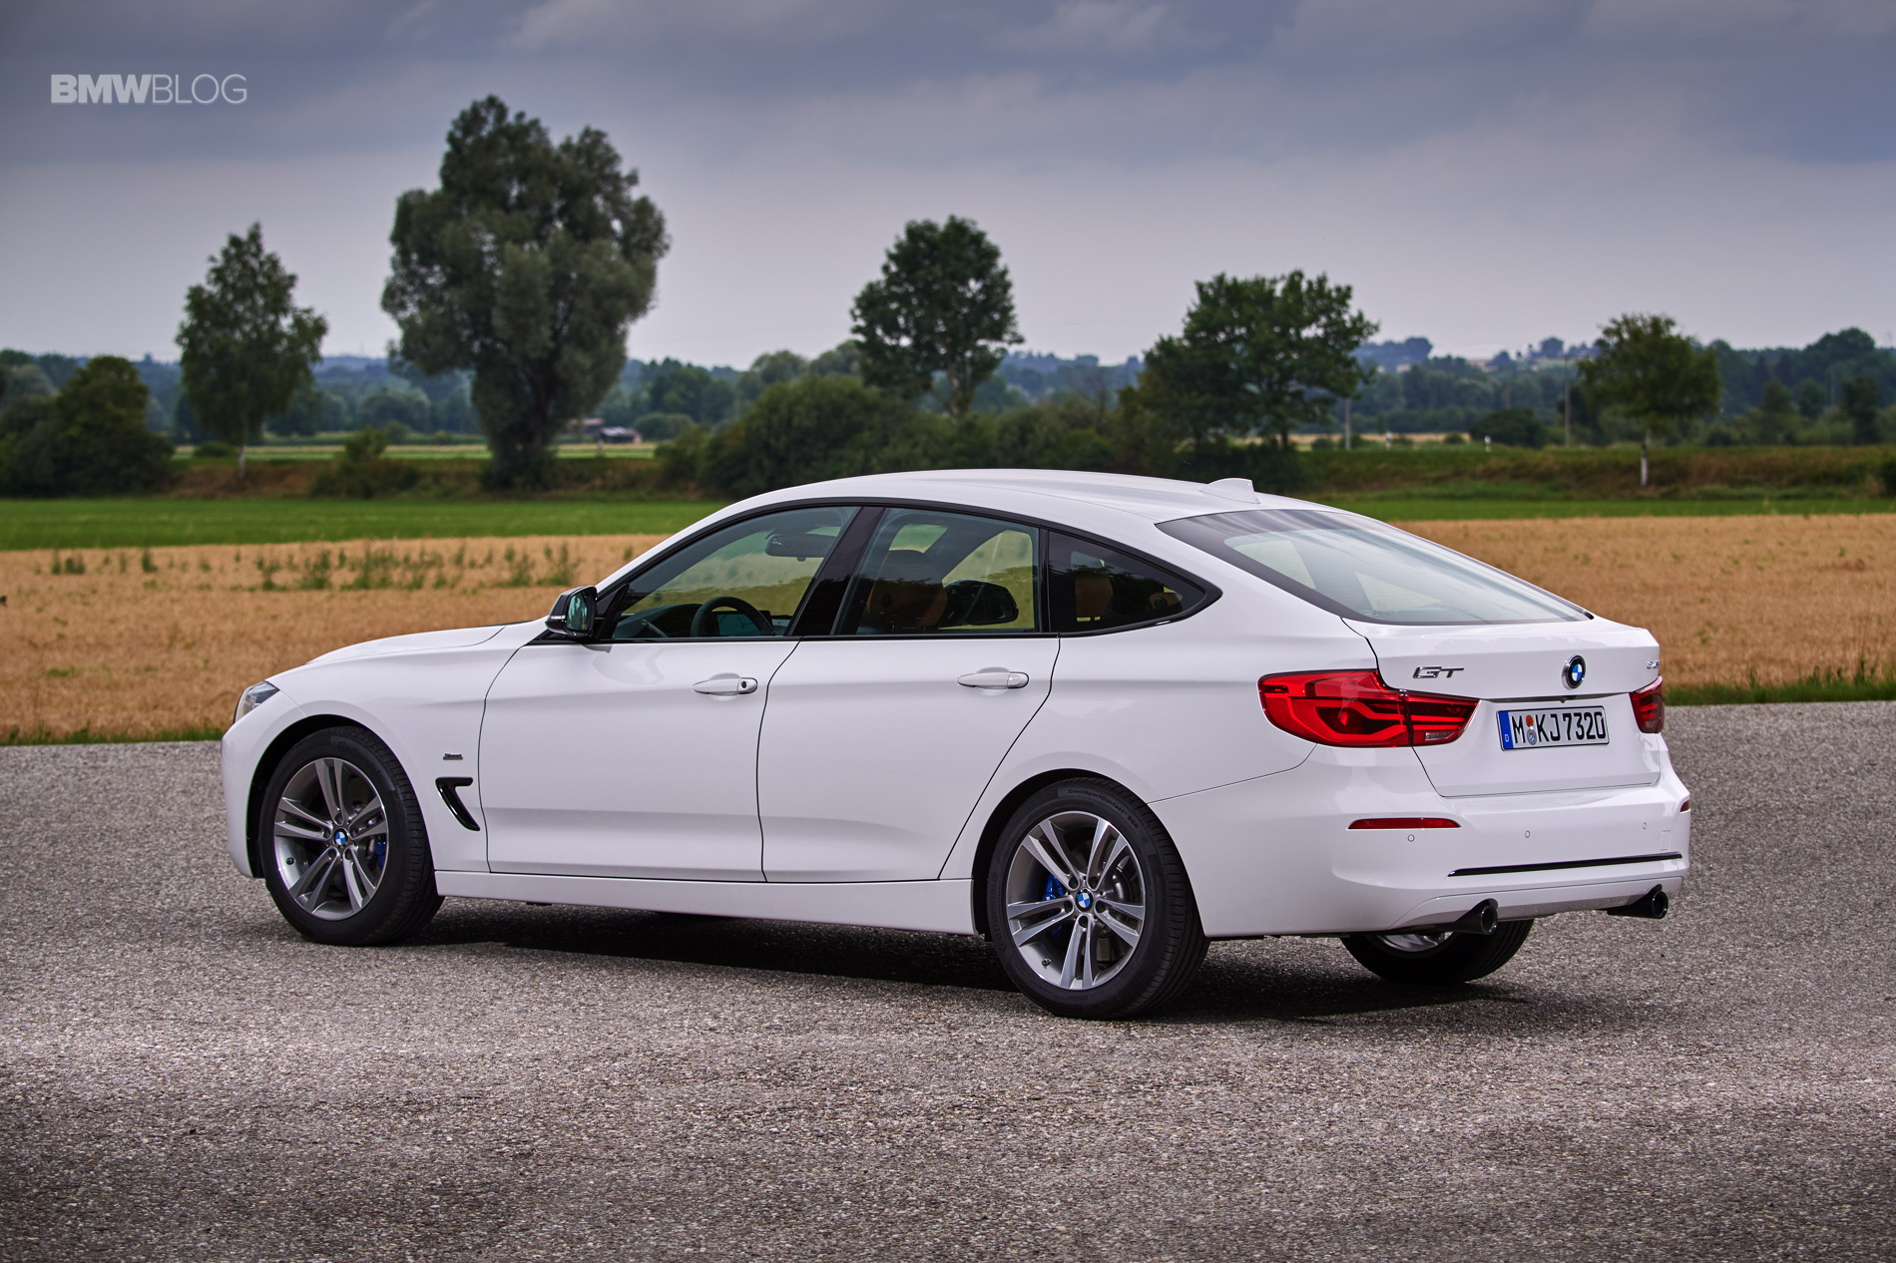
BMW 3 Series
Wagon
Sedan
Gran Turismo
Notes:
Sixth Generation (2011-Present)
Sedans (6 to 8 Trims),
AWD VS FWD
2.0 to 3.0 Liter Turbo Engine
8 Speed Automatic
Wagons and Gran Turismo (2 Trims)
All AWD
2.0 Turbo Engines
8 Speed Automatic

Slide 8






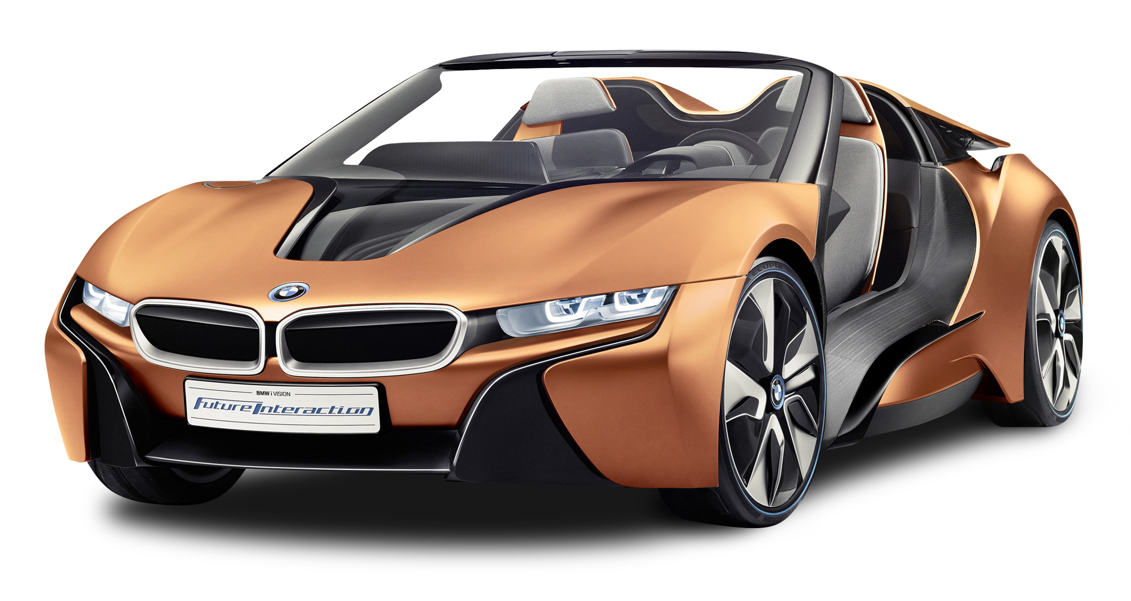
Optional Packages
Lightning
$700
Cold Weather
$800
Convenience Package
$2100
M Sports Package
$2600
Technology
$2750
Premium
$3100
Notes:
Optional Packages:
Light
Cold Weather
Driver Assistance
Technology
Sport
Premium
$500 to $3100
Light
LED Headlights
LED Fog Lights
$700
M Sports Package
Sport Seats
“M” Sport Suspension
P225/45R18(Sport Tires)
18” Premium Alloy Rims
Sport “M” Steering Wheel
$2600
Cold Weather
Heated Seats
Heated Steering Wheel
$800
Technology
Navigation
Head-Up Display
Real-Time Traffic
Remote Services
BMW App Connect
$2750
Convenience Package
Keyless Entry
LED Headlights
Driver Assistant
XM Satellite Radio
$2100
Premium
Moonroof
Satellite Radio (1year)
Keyless Entry
Premium Storage
Leather Seats
$3100

Slide 9
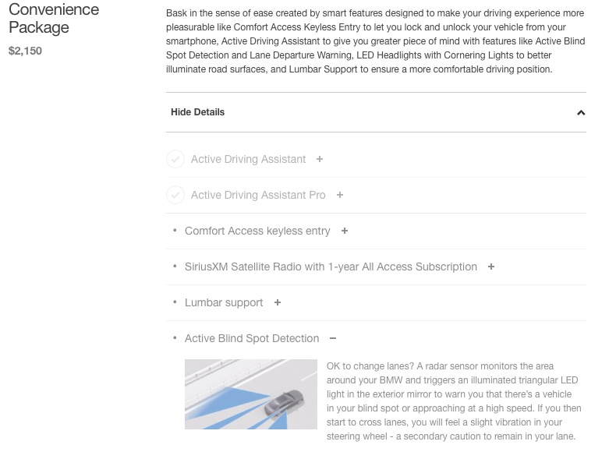

Slide 10

Data Collection/Scraping

Slide 11

Data Explanation
Website Used: https://www.edmunds.com/
Scraped BMW 3 Series 2016-2019
Price
Summary
Options
Notes:
Features were not scraped because they were not consistent
Options were consistent because they were from the manufacturer

Slide 12



Coding Process
Notes:
Extract Links
Scrape Features into lists
Combine into CSV
Dummy code any strings because model only takes integers
Took out any outliers
Run through Multiple Linear Regression Model

Slide 13
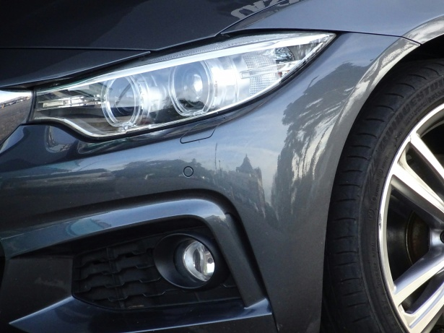
Results

Slide 14

Notes:
Around 300 cars were used predictability

Slide 15

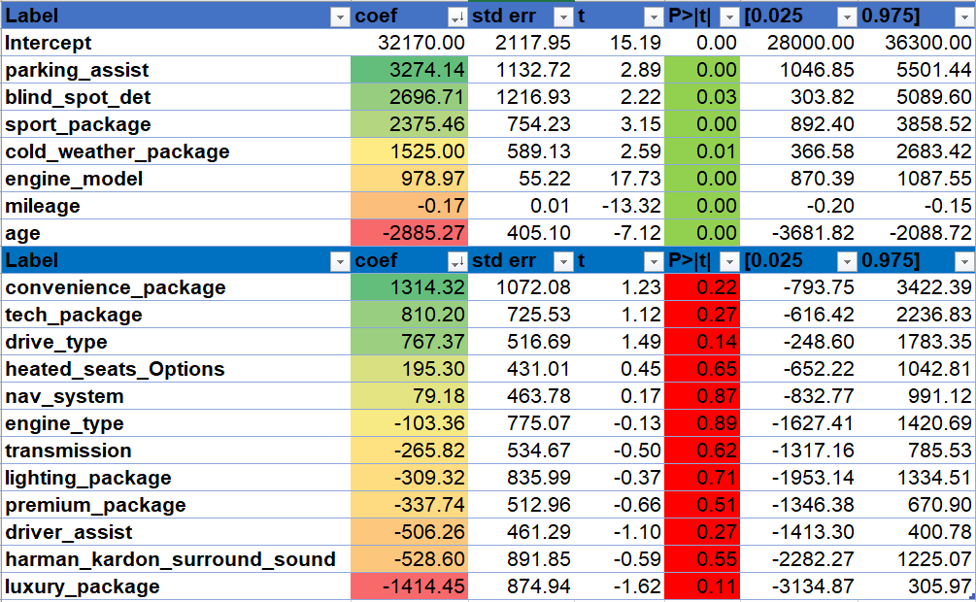
Notes:
Around 300 cars
Sports was a proxy for engine type that was upgraded
luxury cars proxy for age because newer models would have different luxury options
Heated steering not enough records
P values marked less than 5% mean that they are significant to the hypothesis which is- price fluctuates depending on variable
Pvalues marked as red mean tehy are not significant

Slide 16
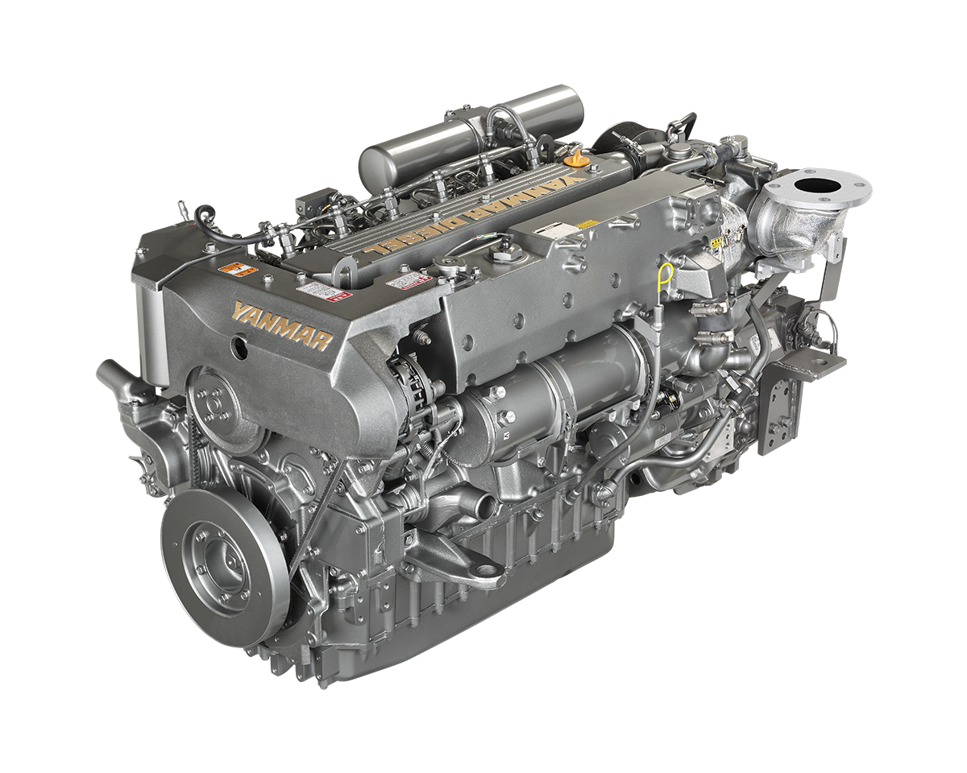



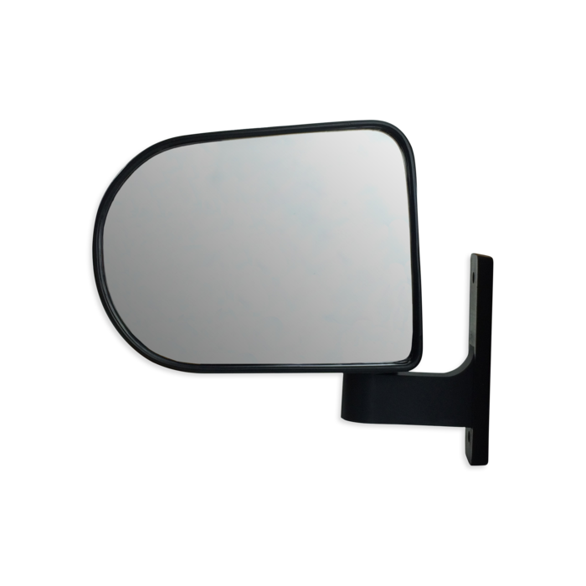



Variables &
Top Predictors
}
}
Notes:
Target Variable- Price
Significantly add Value:
Engine Model
Sport Package
Parking Assist
Cold Weather Package
Blind Spot detection- Not enough records just not it was in the convenience package
Significantly decreases value- mileage age

Slide 17
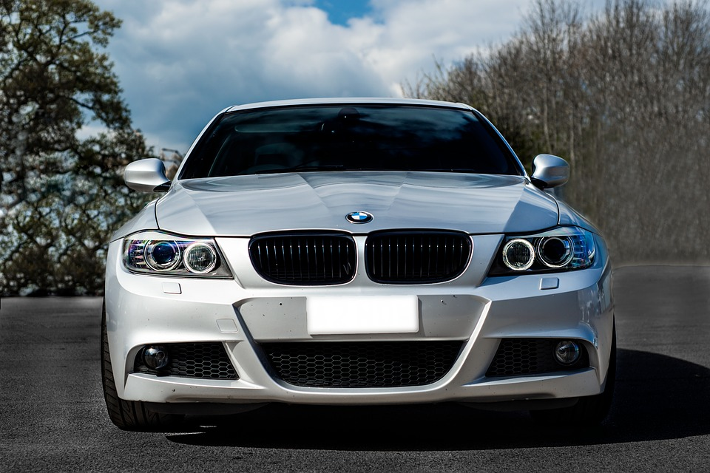
Conclusion
Notes:
Options do not hold significant value compared to what a new customer would paid for them because these cars were new year make cars with low mileage. If we were to expand our search to to even earlier year makes we would find that these options would probably depreciate more than this. Engine models were able to keep their value even as cars were older. One thing to note is that newer options such as the parking assistant were worth more because of their complexity and non obsolete nature in cars however heated seats which is common was not relevant. We found that if you want to get the best value from your car either buying or future selling it is a good idea to skip the options because all of them at some point will be worthless.

Slide 18
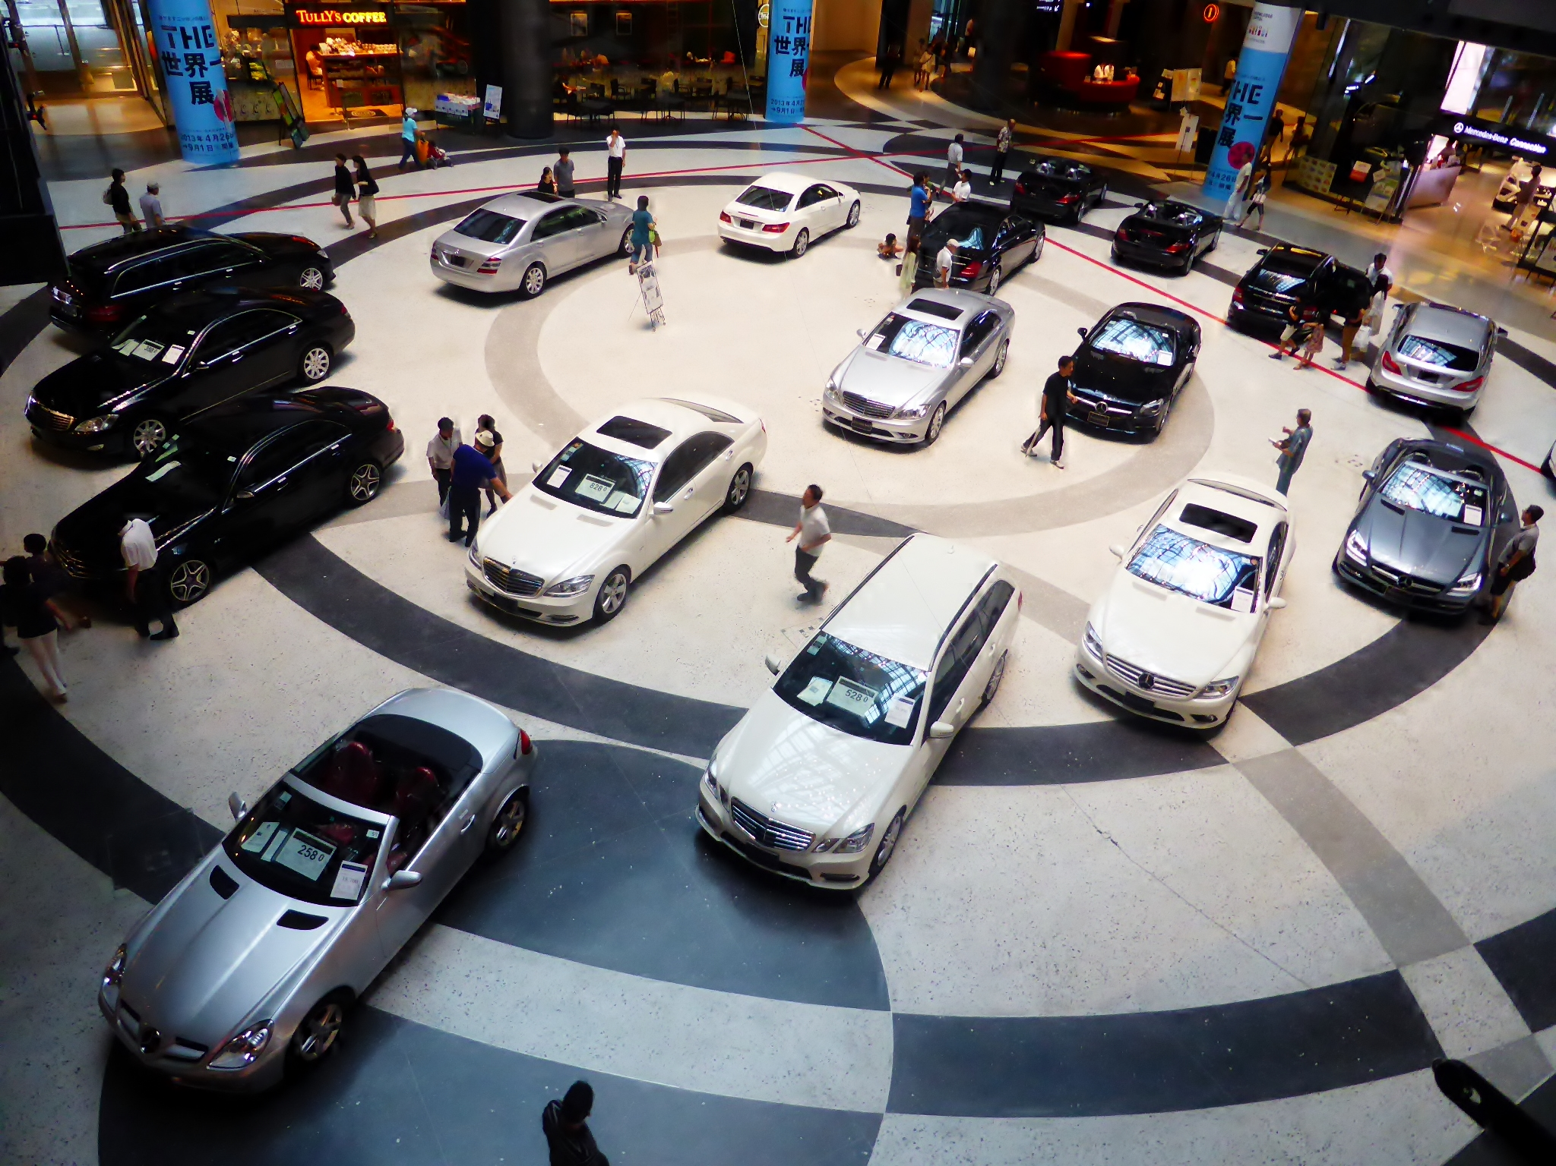
Questions?

